Slide 1
CLUSTERING ALGORITHMS
SUBMITTED BY
P.KEERTHANA,B.E,MBA.

Slide 2
AFFINITY PROPAGATION (AP) CLUSTERING
AP is a clustering algorithm that uses a message passing technique to group similar data points into clusters.
AP takes in a measure of similarity between each pair of data points.
It considers all data points as potential exemplars.
It sends messages between pairs of data points to determine which datapoints are best suited to be exemplars.
It updates the suitability of each data point based on the message it receives.
It repeats this process until the datapoints converge on a set of exemplars and clusters.

Slide 3
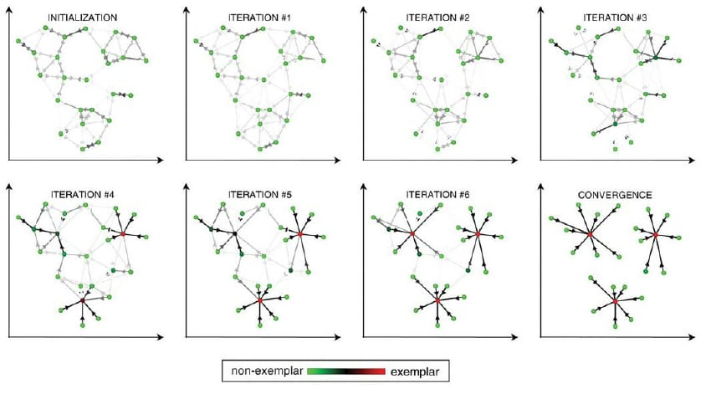
AF CLUSTERING DIAGRAMATIC REPRESENTATION:

Slide 4
Advantages and Disadvantages of Affinity Propagation Clustering:
ADVANTAGES:
Automatic cluster number determination
Flexible similarity measures
Identifies ‘exemplar’ data points
DISADVANTAGES:
Computational complexity
Sensitivity to hyperparameters
Potential for non-globular clusters
Interpretaion challenges

Slide 5
Mean shift clustering
Mean Shift Clustering is a machine learning algorithm that groups data points into clusters based on the average of nearby points.
The algorithm starts with an initial data point as a cluster prototype.
It finds all data points within a certain radius of that prototype.
It shifts the prototype towards the average of those data points.
It repeats this process until the mean converges.
It assigns each data point to the closest cluster center.

Slide 6
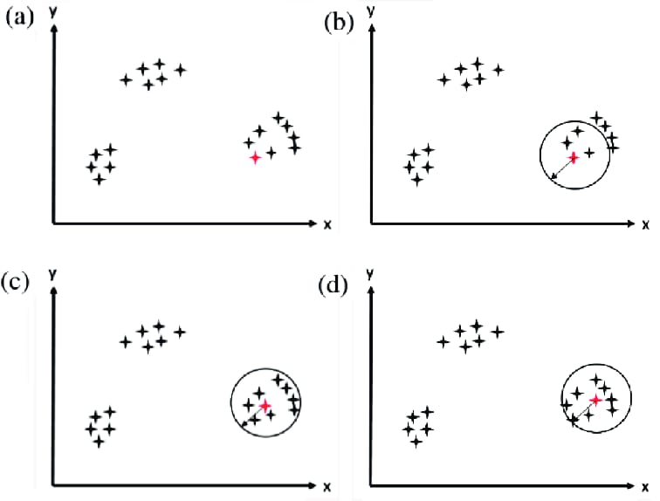
MS CLUSTERING DIAGRAMATIC REPRESENTATION:

Slide 7
Advantages and disadvantages of mean shift clustering:
ADVANTAGES:
It automatically determines the number of clusters.
It’s robust to outliers.
It’s model-free, so it doesn’t assume any prior shape of the data clusters.
DISADVANTAGES:
It can be computationally expensive.
It’s sensitive to the choice of the bandwidth parameter.

Slide 8
Spectral clustering
Spectral Clustering is a machine learning technique that groups similar data points together.
Represent data as a similarity graph.
Use spectral decomposition to reduce the dimensionality of the data.
Cluster the data in the low-dimensional space using algorithms like k-means or k-medoids.

Slide 9
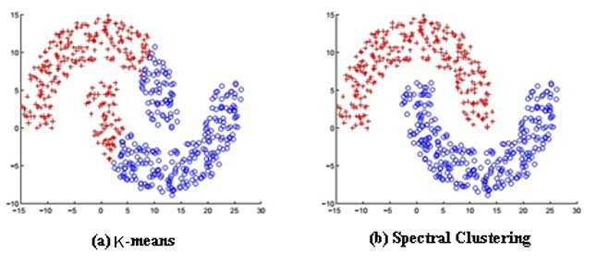
SPECTRAL CLUSTERING DIAGRAMATIC REPRESENTATION:

Slide 10
Advantages and disadvantages of spectral clustering:
ADVANTAGES:
Handles non-convex clusters
Capture global data structure
Effective for high-dimensional data
Relatively easy to implement
Can be used with sparse datasets
DISADVANTAGES:
Computational cost
Sensitivity to hyperparameters
Difficult interpretation
Not suitable for large dense datasets
Requires prior knowledge of the number of clusters.

Slide 11
Dbscan clustering
DBSCAN or Density Based Spatial Clustering of Applications with Noise is a machine learning algorithm that groups data points into clusters.
DBSCAN groups data points that are close together.
It identifies outliers as points that are far from any cluster.
It doesn’t require you to specify the number of clusters in advance.

Slide 12
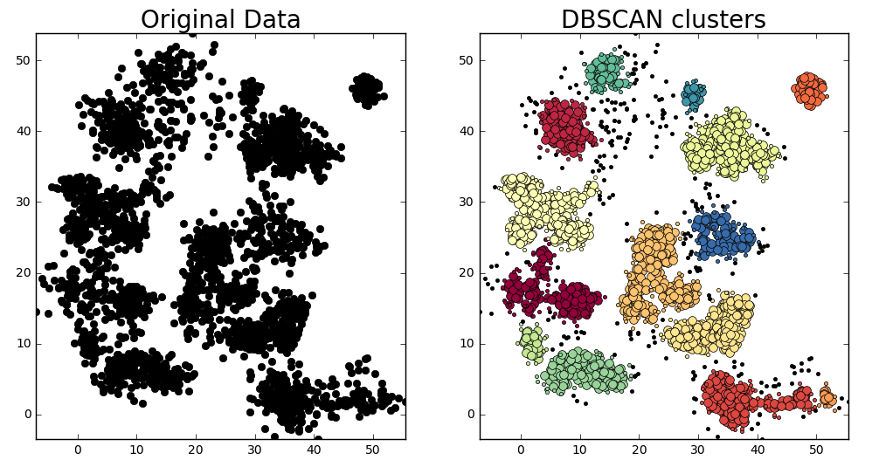
DBSCAN CLUSTERING DIAGRAMATIC REPRESENTATION:

Slide 13
Advantages and disadvantages of dbscan clustering:
ADVANTAGES:
Arbitrary cluster shapes.
Noise handling.
No need to specify cluster number.
Intuitive parameters.
DISADVANTAGES:
Density variation challenge.
Parameter sensitivity.
Computational complexity.
Non-deterministic behaviour.

Slide 14
Optics clustering
OPTICS or Ordering Points To Identify the Clustering Structure is an machine learning algorithm that groups data into clusters based on density.
OPTICS creates an augmented ordering of a database that represents its density-based clustering structure.
It creates a reachability plot, which is a graph that shows the reachability distance of each point.
It identifies outlier points and closely-knit groups within larger groups.

Slide 15
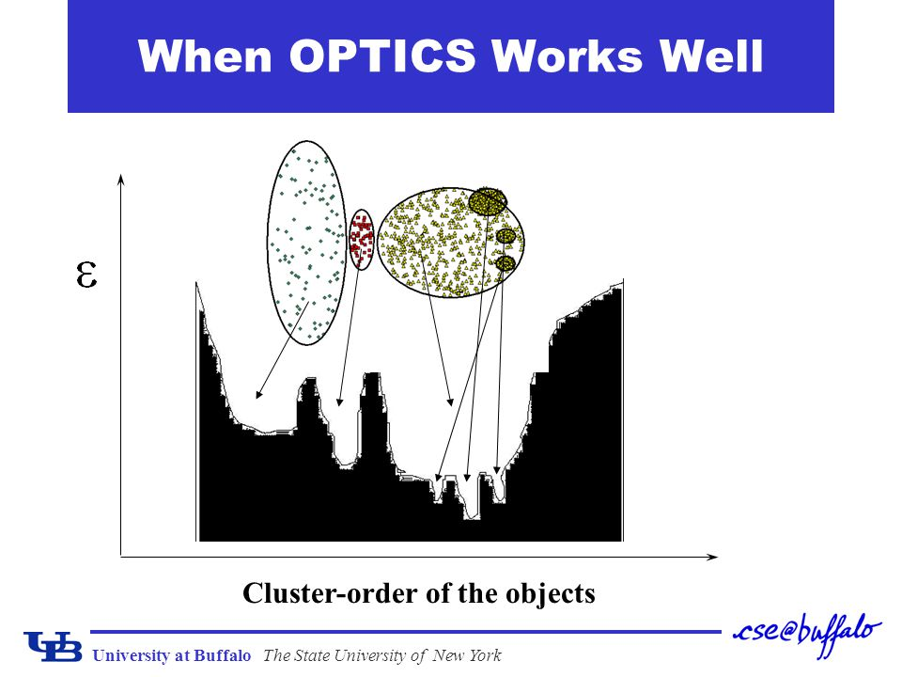
OPTICS CLSUTERING DIAGRAMATIC REPRESENTATION:

Slide 16
Advantages and disadvantages of optics clustering:
ADVANTAGES:
Handles varying densities.
No need to specify cluster number.
Hierarchical structure.
Noise identification.
Identifies complex cluster shapes.
DISADVANTAGES:
High computational complexity.
Parameter sensitivity.
Interpretational complexity.
Memory intensive.

Slide 17
BIRCH CLUSTERING
BIRCH or Balanced Iterative Reducing and Clustering is a machine learning algorithm that groups similar objects into clusters.
BIRCH summarizes large datasets into smaller, denser regions called CF(Clustering Feature) vectors.
It builds a CF-tree, a multilevel hierarchy that fuses smaller clusters into larger ones.
BIRCH uses agglomerative hierarchical clustering to cluster the sub-clusters in the leaf nodes of the CF-tree.

Slide 18
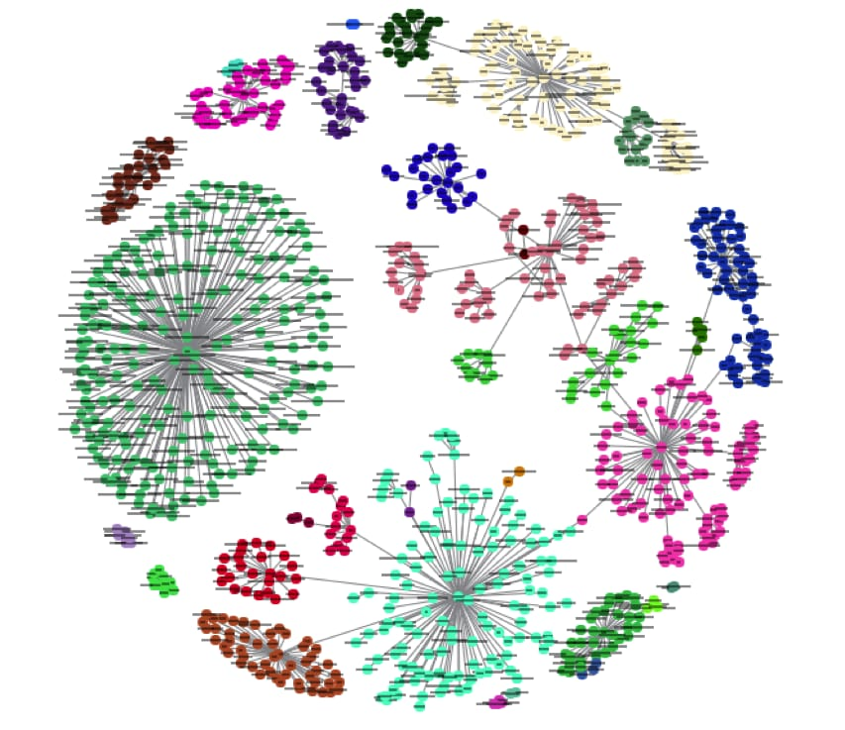
BIRCH CLUSTERING DIAGRAMATIC REPRESENTATION:

Slide 19
Advantages and disadvantages of birch clustering:
ADVANTAGES:
Scalability.
Fast processing.
Incremental clustering.
Noise tolerance.
DISADVANTAGES:
Metric data limitation.
Spherical cluster assumption.
Sensitivity to data order.
Outlier sensitivity.

Slide 20
Applications of Clustering Algorithms:
Image segmentation.
Gene expression analysis.
Network analysis.
Customer segmentation.
Text analysis.
Anamaly detection.
Medical imaging.
Document classification.
Recommendation systems.
Traffic analysis.
Data cleaning.
Data mining.
Pixel classification in images.
Object detection.
Image compression.
Video segmentation.

